Slide 1
Just-In-Time Defect Identiﬁcation and Localization:
A Two-Phase Framework

Slide 2
Background
Some Problems:
Defect localization techniques rely on defect symptoms, i.e., from bug reports or execution traces. However, When a defect symptom is discovered, the defect has already been exposed and it has already negatively impacted the software .
Despite the achievements of JIT defect identiﬁcation, it is also a difﬁcult task to locate the exact buggy positions after a buggy change is identiﬁed, especially for a change that has added many lines of code (LOC)
Notes:
实际上很多人的报告，有一个基于关系的迁移，比如源领域数据中潜在一种师生关系，而目标领域潜在有上下级关系；生物病毒传播---网络病毒传播。

Slide 3
Background
Contributions of the Paper:
The paper proposes a two-phase framework of JIT defect identiﬁcation and localization. This framework can locate suspicious defective lines on change-level at check-in time
The paper conducts an empirical study to evaluate our proposed framework on 14 projects with a total of 177,250 changes. The results show that our framework achieves a reasonable performance, which signiﬁcantly outperforms the baselines by a substantial margin.
Notes:
实际上很多人的报告，有一个基于关系的迁移，比如源领域数据中潜在一种师生关系，而目标领域潜在有上下级关系；生物病毒传播---网络病毒传播。

Slide 4
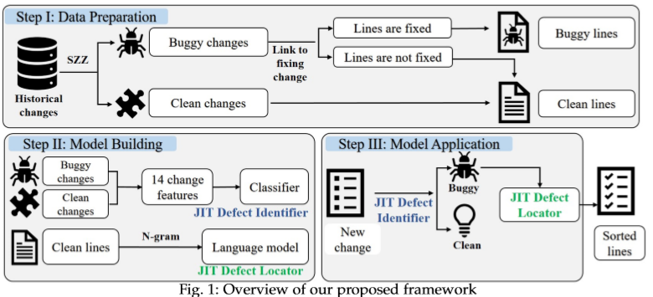
Framework
Overview:
Notes:
实际上很多人的报告，有一个基于关系的迁移，比如源领域数据中潜在一种师生关系，而目标领域潜在有上下级关系；生物病毒传播---网络病毒传播。

Slide 5
Framework
Data Preparation:
Defect-fixing change identiﬁcation
1) search the commit message for references to issue reports, e.g., “Fixed #233”
2) crawl the corresponding issue report from the issue tracking system (ITS) of the project
Buggy change identiﬁcation -- SZZ algorithm
1) ﬁrst leverages the git diff command to identify the lines
2) traces back through the change history to identify the buggy changes by using annotation graph
Buggy and clean lines identiﬁcation
Code tokenization
“System.out.println(graph.summary(InputType.feedForward(5)));”
“System . out . println ( graph . summary ( InputType . feedForward ( 5 ) ) ) ;”
Notes:
实际上很多人的报告，有一个基于关系的迁移，比如源领域数据中潜在一种师生关系，而目标领域潜在有上下级关系；生物病毒传播---网络病毒传播。

Slide 6
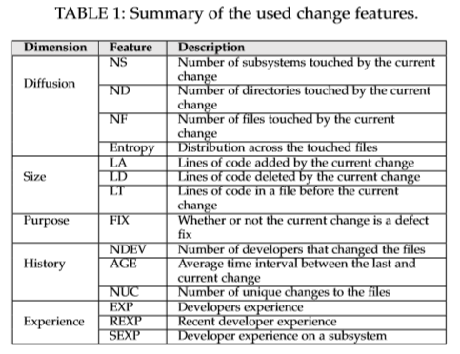
Framework
JIT defect identification model:
Extract 14 change-level features*
Data preprocessing steps (e.g. re-sampling and log transformation)
Build the identiﬁcation model using a logistic regression classiﬁer
A large-scale empirical study of just-in-time quality assurance
Supervised vs unsupervised models: A holistic look at effort-aware just-in-time defect prediction
Notes:
实际上很多人的报告，有一个基于关系的迁移，比如源领域数据中潜在一种师生关系，而目标领域潜在有上下级关系；生物病毒传播---网络病毒传播。

Slide 7




Framework
JIT defect localization model:
N-gram modeling for source code:
Configuration: set N=6
Notes:
实际上很多人的报告，有一个基于关系的迁移，比如源领域数据中潜在一种师生关系，而目标领域潜在有上下级关系；生物病毒传播---网络病毒传播。

Slide 8
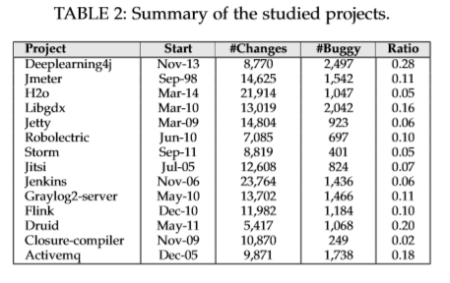
Experiment
Dataset
14 projects from github, 177,250 changes in total
Modal Evaluation
Evaluation setting (identiﬁed-buggy & all-buggy)
Performance measures (MRR & MAP )
Top-k accuracy (k = 1 &5):
Notes:
实际上很多人的报告，有一个基于关系的迁移，比如源领域数据中潜在一种师生关系，而目标领域潜在有上下级关系；生物病毒传播---网络病毒传播。

Slide 9
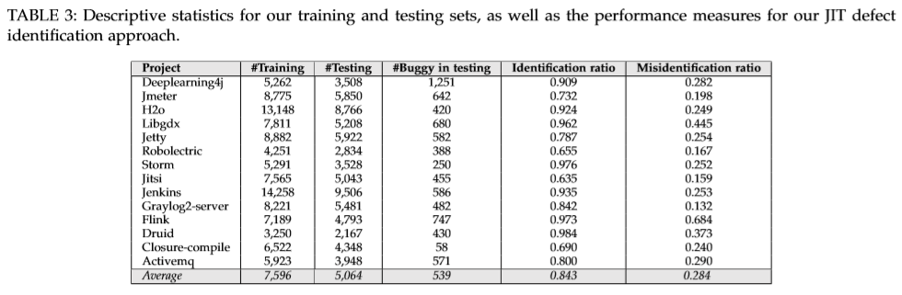
Results
RQ1: Performance of proposed framework
Notes:
实际上很多人的报告，有一个基于关系的迁移，比如源领域数据中潜在一种师生关系，而目标领域潜在有上下级关系；生物病毒传播---网络病毒传播。

Slide 10
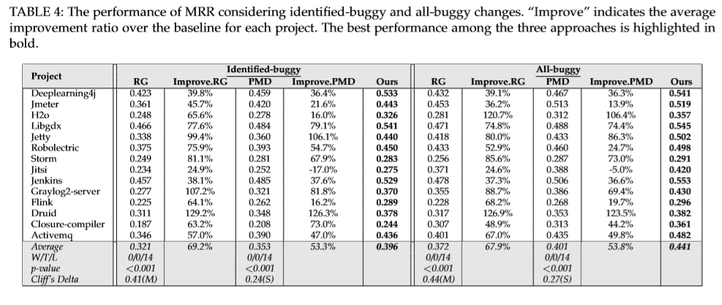
Results
RQ1: Performance of proposed framework
Notes:
实际上很多人的报告，有一个基于关系的迁移，比如源领域数据中潜在一种师生关系，而目标领域潜在有上下级关系；生物病毒传播---网络病毒传播。

Slide 11
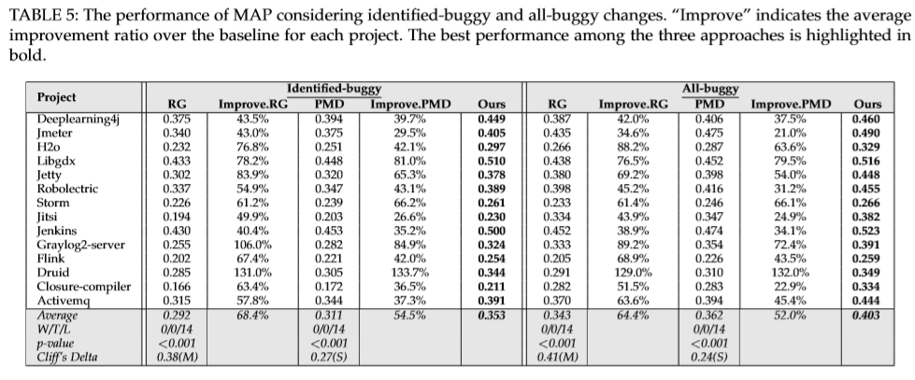
Results
RQ1: Performance of proposed framework
Notes:
实际上很多人的报告，有一个基于关系的迁移，比如源领域数据中潜在一种师生关系，而目标领域潜在有上下级关系；生物病毒传播---网络病毒传播。

Slide 12
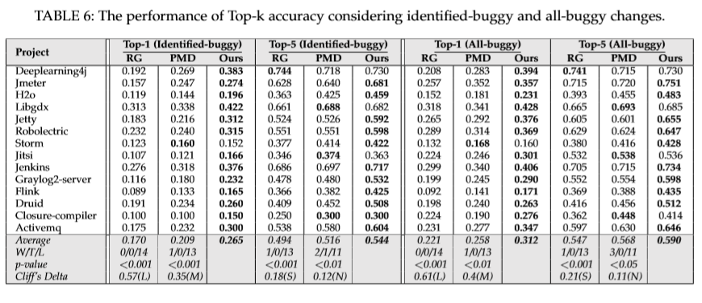
Results
RQ1: Performance of proposed framework
Notes:
实际上很多人的报告，有一个基于关系的迁移，比如源领域数据中潜在一种师生关系，而目标领域潜在有上下级关系；生物病毒传播---网络病毒传播。

Slide 13
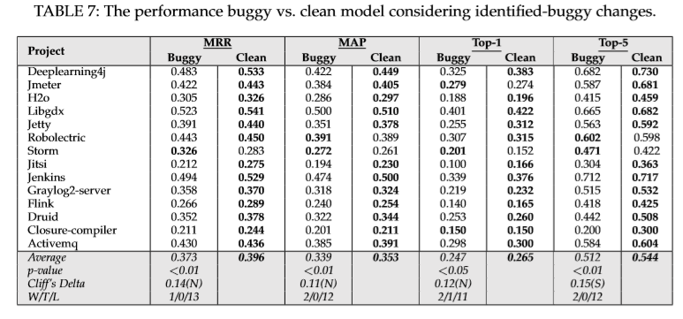
Results
RQ2: Effectiveness of buggy model
Notes:
实际上很多人的报告，有一个基于关系的迁移，比如源领域数据中潜在一种师生关系，而目标领域潜在有上下级关系；生物病毒传播---网络病毒传播。

Slide 14
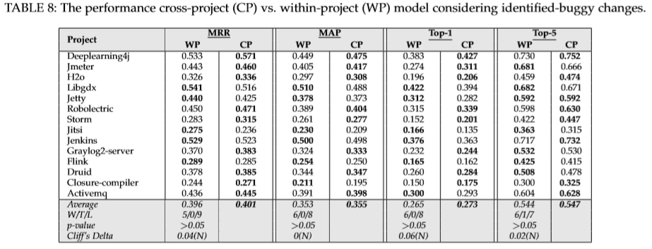
Results
RQ3: Performance of cross-project model
Notes:
实际上很多人的报告，有一个基于关系的迁移，比如源领域数据中潜在一种师生关系，而目标领域潜在有上下级关系；生物病毒传播---网络病毒传播。

